Slide 1


DRIVER DROWSINESS
DETECTION SYSTEM
CS348 – SOFTWARE GROUP PROJECT
18DCS046 - Shubham Mendapara
18DCS054 - Krish Pabani
18DCS058 - Yash Paneliya
Supervisor : Prof. Vidhi Pandya
Batch : 5CSE1 - C batch
Domain : ML & DL

Slide 2
TABLE OF CONTENTS
01
INTRODUCTION
TECHNOLOGY
02
03
HOW IT WILL WORK
LIMITATION
04
05
IMPLEMENTATION
FUTURE SCOPE
06
07
CONCLUSION
REFERENCES
08

Slide 3
01
INTRODUCTION

Slide 4
DRIVER DROWSINESS DETECTION SYSTEM
Points we are going to cover in our project are:
You’ll never get Sleepy at driving time!
Sound start if person found Drowsy.
Help to avoid accident.

Slide 5
02
TECHNOLOGY

Slide 6
OpenCV
TensorFlow
Used for detection of face and eye of person
Used as a backend for keras
Keras
Build classified model

Slide 7
HOW IT WILL WORK
03

Slide 8
Step 1
Step 3
Step 5
Take image from camera
Detect eyes
Percentage
Of
Drowsiness
Step 2
Step 4
Detect face
Classify eye open or not

Slide 9
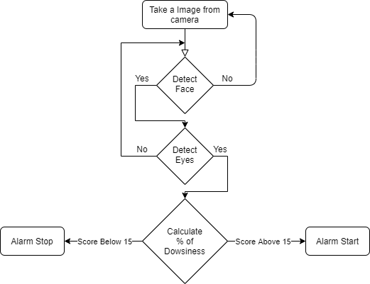
FLOW CHART

Slide 10
04
LIMITATION

Slide 11
Not tested in real life.
Not highly accurate model.
Fails sometimes when person yawns

Slide 12
05
IMPLEMENTATION

Slide 13
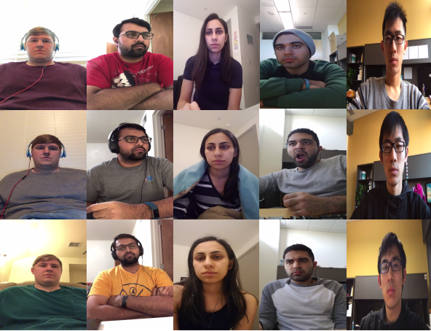
DATASET SNAPSHOT

Slide 14

In Proper Light Condition

Slide 15
In Low Light Condition

Slide 16
06
FUTURE SCOPE

Slide 17
Testing in real life situations
Improving Dataset
Increasing accuracy

Slide 18
07
CONCLUSION

Slide 19
This project was a new experience for us.
This project will help to solve real life problems.
We got to learn how to develop a ML model and how to work with Data Set.
Notes:
This project will help us to solve real life problems. This will reduce the no. of accidents happening due to some carelessness of driver and will save many lives.

Slide 20
08
REFERENCES

Slide 21
Understanding Deep
Learning
Learning Keras
About TensorFlow
Learning use of OpenCV

